Slide 1
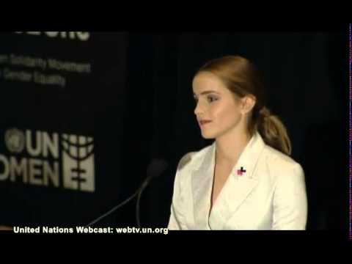
Speech
Emma Watson: Gender Equality is your Issue too
Speech by UN Women Goodwill Ambassador Emma Watson at a special event for the HeForShe campaign, United Nations Headquarters, New York, 20 September 2014

Slide 2
Purpose, Context, Form
Speech given at the UN Headquarters: UN purpose in general is to give equal rights for all
To promote her HeForShe campaign
Advocate Gender Equality
Aimed at both men and women: This idea that both genders are responsible for bringing about a change of gender equality.

Slide 3
Style
Passionate Tone
With personal opinion and voice
Humour and Anecdotes used to create a lighter tone and to come across as likeable
Aimed at everyone -> Language is easy to understand, simple
Positive tone to encourage a positive change

Slide 4
Language
“Both men and women should feel free to be sensitive. Both men and women should feel free to be strong… It is time that we all perceive gender on a spectrum not as two opposing sets of ideals.”
Ellipses- Slows down pace to create dramatic pause in speech. It also puts emphasis on the next line.
Repetition ‘Both men and women’ - emphasizes this inclusive outlook targeting men as well as women. Also raises less common opinions on feminism.
‘Two opposing sets of ideals’ - ‘Sensitive vs. Strong’ - Addresses stereotypical characteristics of men and women saying they shouldn’t be exclusive to just one gender but there should be a ‘spectrum’.
Repetition of ‘free’: emphasize the idea of gender equality = freedom

Slide 5
“You might think, ‘Who is this Harry Potter girl? What is she doing at the U.N.?’ And it’s a really good question — I’ve been asking myself the same thing,”
Rhetorical question - Self deprecating, humorous tone. She comes across as likable, relatable.
“I am inviting you to step forward, to be seen to speak up, to be the "he" for "she". And to ask yourself if not me, who? If not now, when?”
Rhetorical Question and List of 3 Encouraging listeners to take action. “inviting”
Personal Pronouns to make listeners feel involved

