Slide 1
Magazine Article
The language, form and style

Slide 2
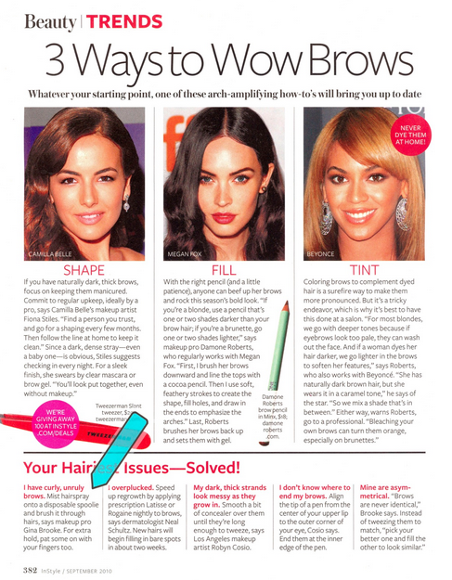
The article
http://ginabrooke.com/wp/wp-content/uploads/2013/01/Article-Only_pg1jpg.jpg

Slide 3
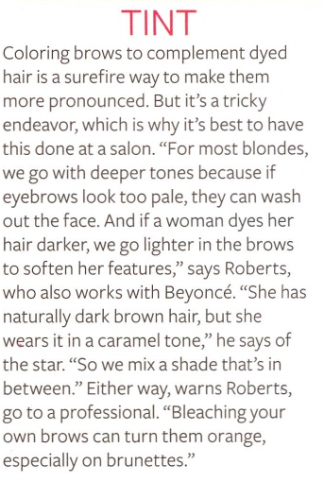
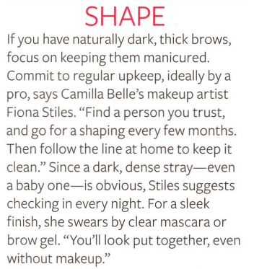
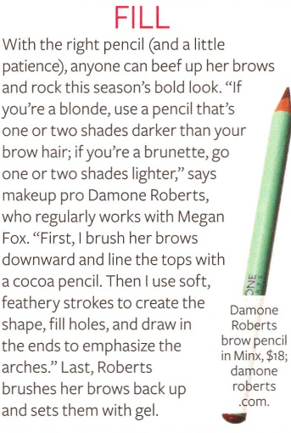

Slide 4
Style
Tone - The tone of the text is informal trying to be mature. - It uses informal language yet tries to keep a sense of maturity about it - As it is teen vogue it is aimed at teenage girls transitioning between being a kid and a woman, they want to act like they are all grown up however they still have immature tendencies, this is reflected in the article
“Anyone can beef up her brows and rock this seasons new look”

Slide 5
Form
The Pictures juxtaposed with the text underneath make it easy to understand what you are reading as you have an example
The picture allows you to really understand the meaning of the writing.
A magazine article has a simple structure, usually in columns as seen in this article
They use lots of quotes to make it seem like it is legitimised

Slide 6
Language

